Slide 1
Life After Fukushima:
What is the Impact on Japan’s Economy
“The Future of Nuclear Power in a Post-Fukushima World”
October 19, 2011
Kiichiro Sato
JETRO New York

Slide 2
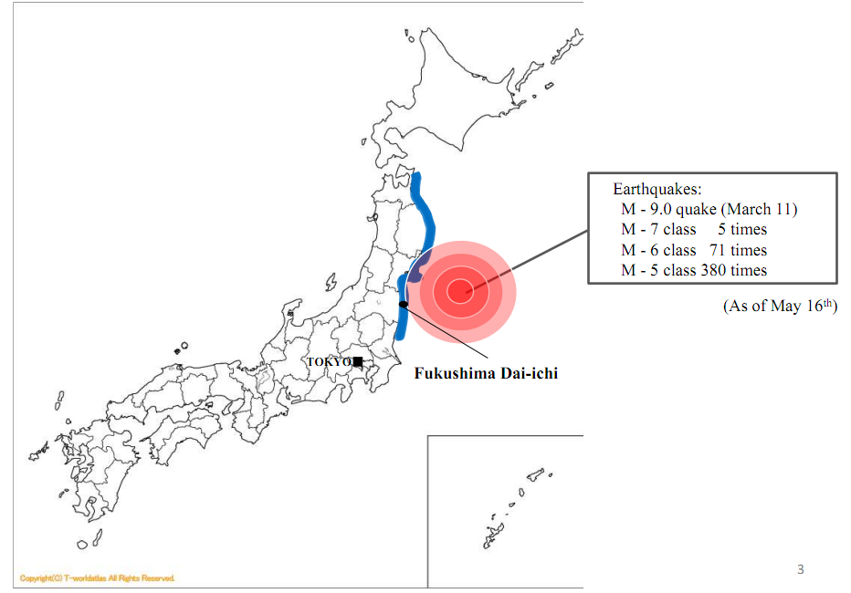
Japan Faces an Unprecedented Challenge
Earthquakes
  Main shock
  Magnitude : 9.0 (Mar. 11th)
  Aftershocks
  M7 or greater : 6 times
  M6 or greater : 93 times
  M5 or greater : 559 times
  (As of Aug. 31st)

Slide 3
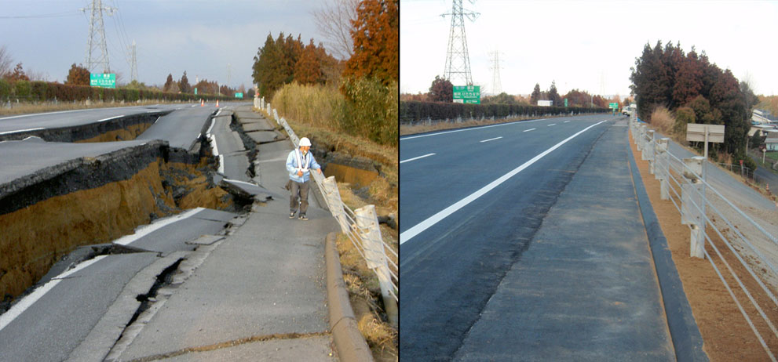
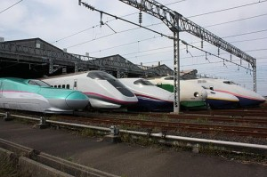
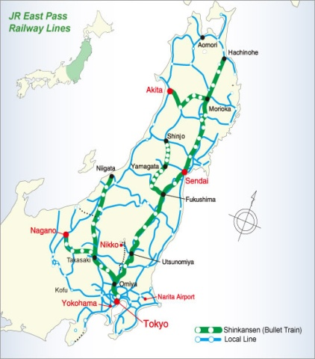
Quick Facts on the Speed of Recovery
A road in the town of Naka was returned to normal in 6 days
None of the 26 Bullet trains operated by JR East at the time of the earthquake derailed nor was there any serious damages
April 29th – All Tohoku Shinkansen resumed operation
June 13th – All Tohoku, Yamagata, and Akita Shinkansen service has been restored

Slide 4
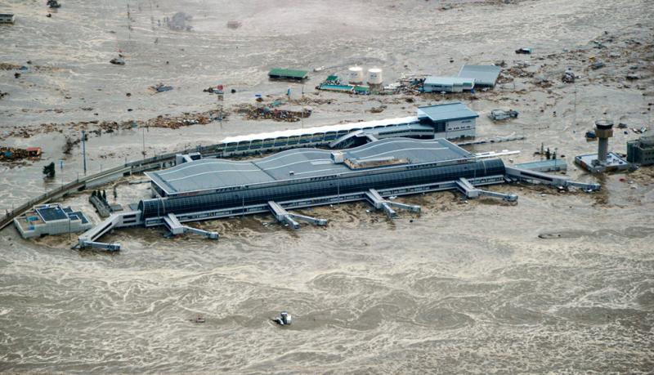
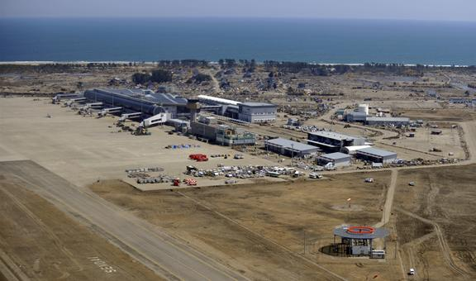
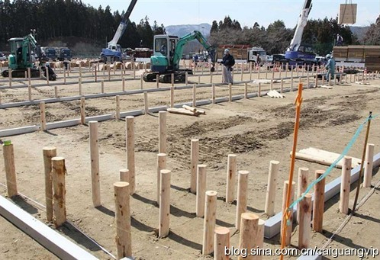
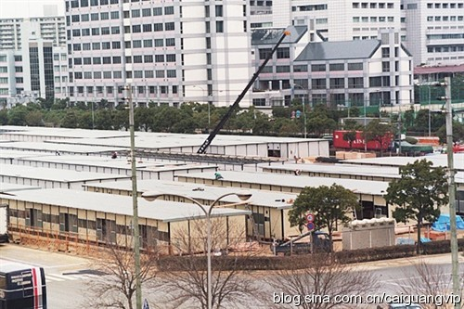
Quick Facts on the Speed of Recovery
Rebuild of Sendai Airport affected by Tsunami
2.5 weeks later
Building of temporary housings
2 weeks later

Slide 5
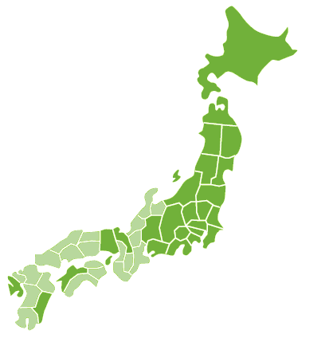
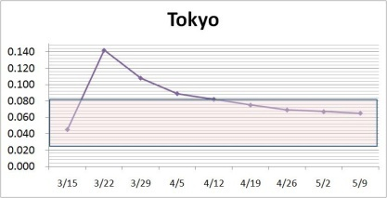
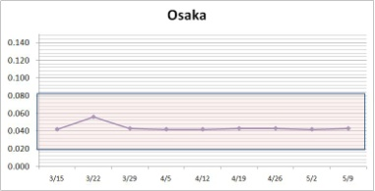
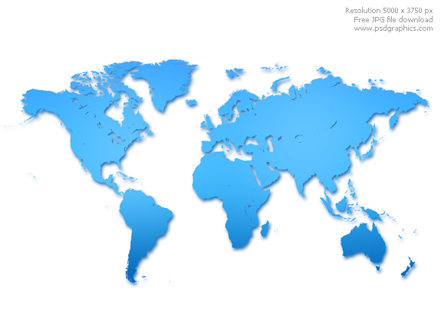
Radioactivity Monitoring
Monitoring in Japanese Agriculture
(As of July 21)
Radiation level in the air
 | Tokyo | Osaka
Radiation level in the air
Distance from Fukushima | Approx. 234 km (148 miles) | Approx. 562 km (349 miles)
Sapporo:
254 μ Sv / year
Aomori:
245 μ Sv / year
Nigata:
403 μ Sv / year
Sendai:
534 μ Sv / year
New York: 815 μ Sv / year
(As of May 17)
London: 2200 μ Sv / year
(As of April 1)
Ehime:
420 μ Sv / year
Fukushima Daiichi Nuclear Power Plant
Tokyo:
511 μ Sv / year
Osaka:
368 μ Sv / year
Paris: 701 μ Sv / year
(As of June 5)
Beijin: 526 μ Sv / year
(ave. between May 31 – June 1)
Miyazaki:
231 μ Sv / year
Moscow: 964 μ Sv / year
(ave. between May 27 – June 2)
5

Slide 6
Impact on the Supply Chains
Caused by the Earthquake and Rolling Blackouts (Examples)
Raw materials
The coastal industrial region（ The stricken area ）
［ ％］：global market share
Hydrogen peroxide solution
○Ｃ company
（c factory ） etc.
○A company expects to get over by using inventory sources and resume its material factory immediately.
Graphite［90％］
（For battery’s negative electrode ）
○Ｄcompany （d factory ）［４８％］ etc.
○ A company has resumed its operations immediately.
Ultra-slim copper foil ［100％］
○Ｇ company （ｇａ factory）［２０％］, Ｈ company（h factory ）［１８％］ etc.
○ A company reduced its production by more than 80%.However, full-scare operation would resume in early May.
Ethylene
○Ｖcompany（ｖ factory） etc .
○A company expects to resume its operations in middle of May
ITO targets
○Ｇ company （ｇｂ factory ）［４０％］ etc.
○ A company resumes its operations one by one, and full-scare operation would resume in end of July.
Silicon wafers ［66％］
○Ａ company （a factory ） ［３３％（whole company）］, Ｂ company （ｂ factory ）［２９％（whole company）］ etc.
○ Though a company reduced its production by about 40%, it resumes its operations one by one.
Synthetic quartzs ［100％］
○I company （i factory ）［５０％ （whole company） ］、Ｊcompany（ｊfactory ）［２２％（whole company）］ etc.
○ A company resumes its operations one by one.
Speciality elastomer （EPDM）
○Ｅ company （e factory ）etc.
○A company had already recovered its damaged machineries, and expects to resume operations in May.
Intermediate Goods
Lithium-ion batteries
○Ｗ company （ｗａ factory, ｗｂfactory, ｗｃ factory ）［２０％］、Ｘcompany（ｘ factory ） etc.
○ A company resumes its operations one by one.
Semiconductors
○Ｌ company （ｌ factory ）［MCU３０％（whole company）］、Ｍcompany（m factory ）［Chip for NC ５０％］ etc.
○L company(l factory) expects to resume operations in middle of June. It is considerably early compared with the previous schedule.
Liquid crystal panels
＜Medium and small size of liquid crystal panels＞ ［For ｓmartphone 約７０％ ］
○Ｐ company （ｐ factory ）, Ｑ company （ｑ factory ） etc.
○ A company expects to resume its operation in end of April.
＜ Large size of liquid crystal panels ＞
○Ｒ company （ｒ factory ）
○ A company resumes its operations one by one from end of April.
End-products
Automobiles
○At present, companies reduce their production level to 50～60％ , but from July, they would increase its productions one by one, and the production rates is expected to get back to normal in November or December.
Flat panel TVs ・Smartphones
○Though some of parts companies were damaged, there is no impact on the productions.
Industrial machineries
○Most of factories has resumed their operations.
Comsumer electronics・Electronics
○Most of factories has resumed their operations.
6

Slide 7
Production bases in the affected area
have been restored rapidly
As of April 2011, more than 60% of disaster-affected production bases in the manufacturing industry had been completed restored.
As of end of June, 93% have been restored.
7

Slide 8
Industrial Production of Japan
In August, industrial production recovered to 96% of pre-earthquake level.

Slide 9

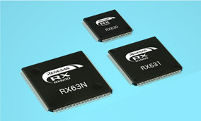
Case of RENESAS
RENESAS is a semi-conductor maker, ranked 3rd in the world market.
RENESAS produces.
30% of micro computer in the global market
One of the plants (NAKA Plant in IBARAKI Prefecture) is located in the affected area.
Initially, it was expected to resume operation in September, but actually resumed in June.

Slide 10
Case of RENESAS
A banner on the plant “Show Renesas’s inner strength and unite our hearts to restart production in June. Customers world wide are waiting for Renesas’s recovery.”
24/7 work to restoration
80,000 engineers gathered to NAKA plant; from auto makers, electronics companies, construction companies, semiconductor companies even competitors, to support recovery.
Had meeting twice a day. Visualize all the process and progress of recovery by putting large pieces of paper on the wall, which enabled share issues and led healthy competition and coordination among teams.
Speedy alternated production in another Renesas plants. This scheme had been built since M&A in 2010. “FAB Network” is to enhance flexibility of production in response to sudden acceleration of demand or in emergency.
Source: “Renesas, Recovery” (video uploaded on youtube by Renesas)

Slide 11
Case of RENESAS
“I witnessed very strong GENBA (field site). You are the symbol of recovery of JAPAN not only of Nissan.” (Carlos Ghosn, CEO of Nissan-Renault, at Iwaki Nissan plant) Source: Nikkei (September 11, 2011)
high morale toward recovery;
  All Hands on Deck
  Customers all over the world are waiting for our
  products
  Support and cooperation from business partners
  or beyond rivalry
high responsibility and leadership shown by each
division’s leaders
- Sharing issues, making decision quickly
exceeding technological capability

Slide 12
Economic Trends in US & Japan
US: Decreased pace of economic recovery in the first half of 2011
Japan: Severe economic slowdown due to the large impact of the earthquake in the first half of 2011
Actual and Forecasted GDP Growth Rate for US & Japan
Forecast
Source: US Department of Commerce, Cabinet Office
Japan Cabinet Office 2011 Mid-Long term Economic and Fiscal Projections

Slide 13
Reexamination of the current
Strategic Energy Plan
June 2010
“The Strategic Energy Plan” enacted
August 2011
“Interim Report on Strategies to
Revitalize Japan” (Cabinet Decision)
⇒Government will formulate “innovative energy and environmental strategies” in 2012
(100mil kWh)
9%
21%
26%
25%
53%
28%
11%
13%
13%
2%
6/2011 Overview of Energy Policy Review (METI)

Slide 14
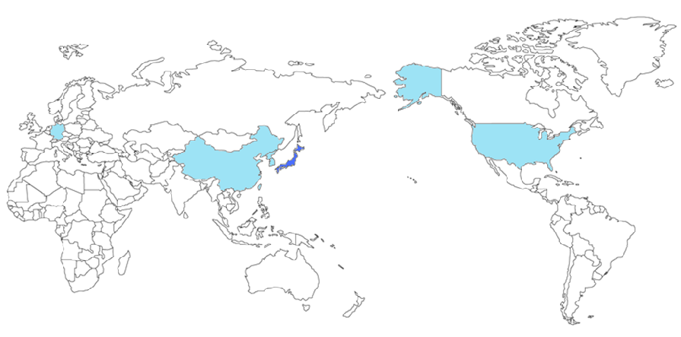
Movement of Non-Japanese Companies
to Japan
Smart Grid
Solar Power
Company Name | Country | Movements
General Electric | USA | Joint Venture with Fuji Electric in February
IBM | USA | Initiated R&D in Kita-Kyushu City
Hewlett Packard, SAP | USA | Working on a smart grid system in Chiba Prefecture
Company Name | Country | Movements
SunPower | USA | Toshiba has made a distribution agreement
Canadian Solar | Canada | Selling there solar panels to Japanese companies
Q-Cells | Germany | Established a sales office in Japan
Yingli Green Energy | China | Collaborated on sales with Japanese companies
Trina Solar | China | Sales distributors have increased to 10,000
Suntech Power | China | Acquired 2 Japanese companies
JA Solar | China | Plans to establish an office by September 2011
Hanwha Group | Korea | Plans to distribute to Japan in August 2011
Motech | Taiwan | Manufacture solar panels in Hokkaido region
Wind Power
Company Name | Country | Movements
Gold Wind | China | Collaborate with Japanese company to create a low cost wind generator
Source: Nikkei Business Daily 2011/7/13, Nikkei Newspaper 2011/8/6

Slide 15
Japanese Companies
Newly Opened Business in the US

Slide 16
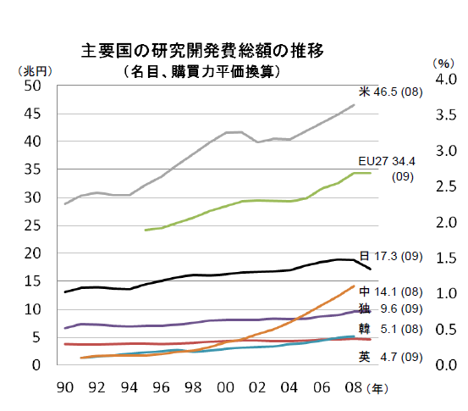
Trend In R&D Expenditures in Major Countries
Change in Total R&D Expenditures in Major Countries
(Nominal Purchasing Power Parity)
(trillion yen)
US
EU
Japan
China
Germany
Korea
UK
Source: Survey on scientific and technological research (Ministry of Internal Affairs and Communications);
Main Scientific and Technology Indicators (OCED)

Slide 17
THANK YOU
For more information, please visit www.jetro.org

